Slide 1



Tutorial ESWC 2018: From heterogeneous data to RDF graphs and back
Olivier Corby, Catherine Faron Zucker,
Maxime Lefrançois, Antoine Zimmermann
ESWC 2018 tutorial - 4th June 2018

Slide 2


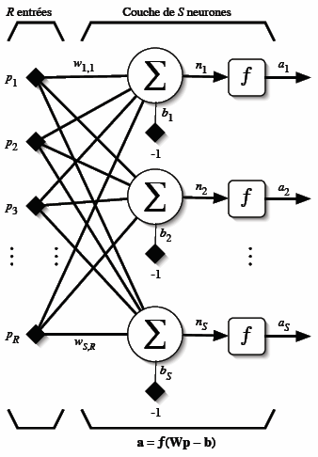


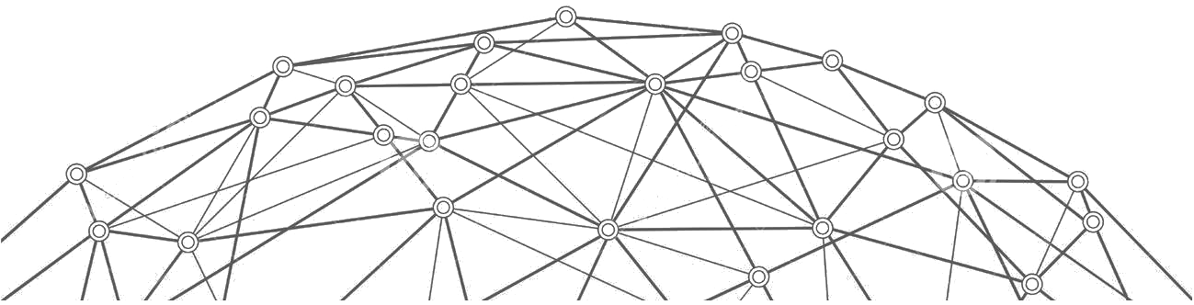
Connected devices
Data
Services
Humans
World Wide Web

Slide 3
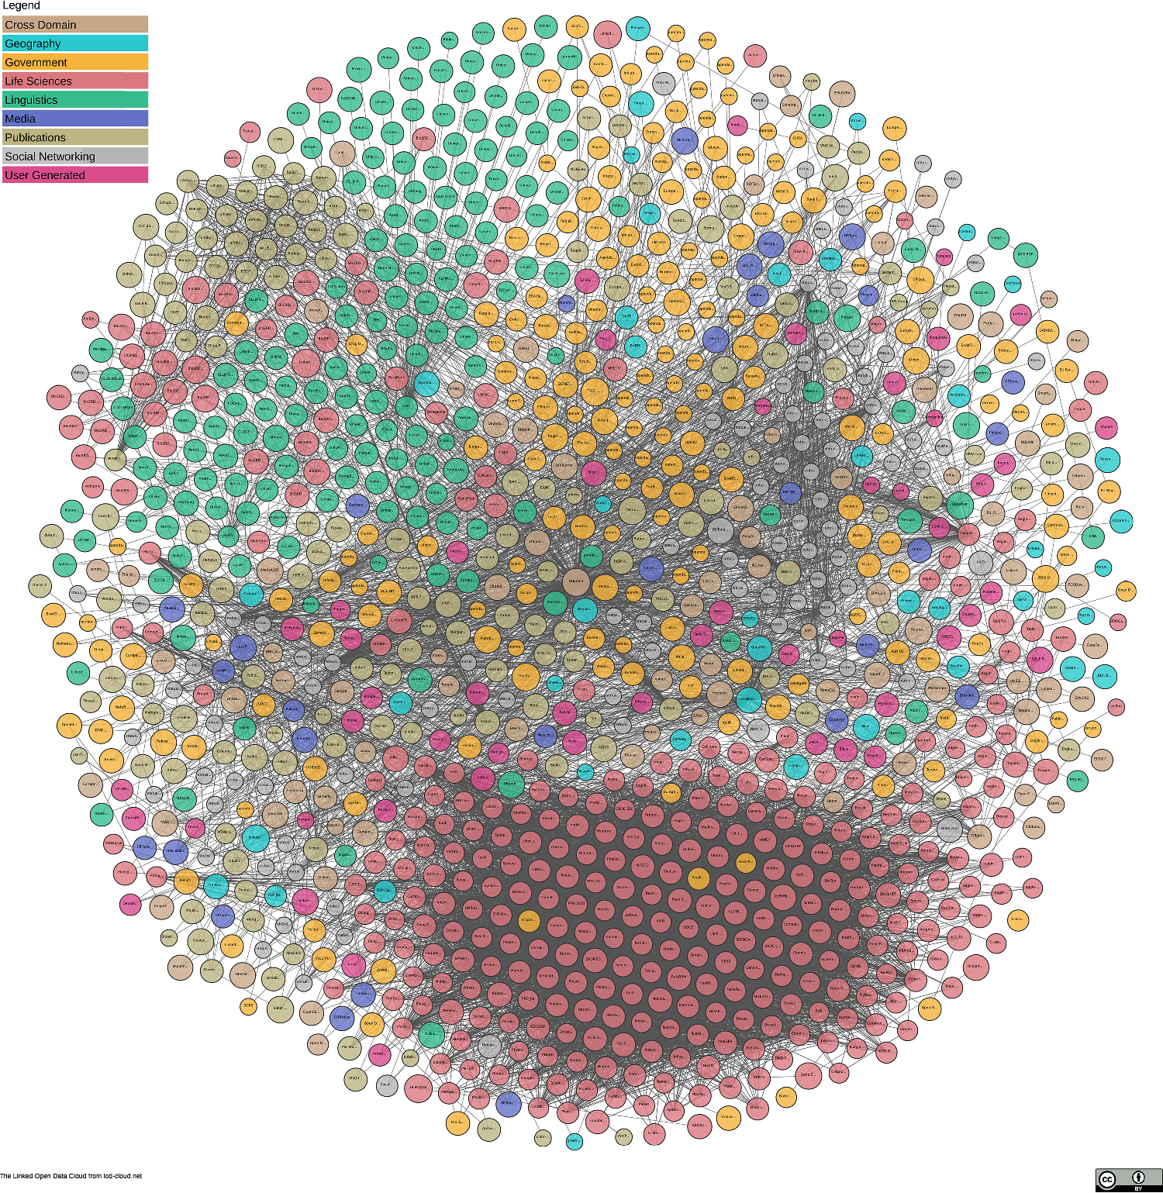
Where is RDF ?
World Wide Web

Slide 4
RDF as a lingua franca
to reach semantic interoperability
integration and querying of data having heterogeneous formats
RDF
Heterogeneous data
RDF lifting
SPARQL-Generate
RDF transformation
STTL

Slide 5
Publications on SPARQL-Generate
Publications on STTL
Corby Olivier, Faron-Zucker Catherine and Gandon Fabien. LDScript: a Linked Data Script Language. International Semantic Web Conference. Springer, Cham, 2017.
Corby Olivier and Faron-Zucker Catherine. STTL: a SPARQL-based transformation language for RDF. International Conference on Web Information Systems and Technologies. 2015.
Lefrançois, Maxime; Zimmermann, Antoine; and Bakerally, Noorani. A SPARQL extension for generating RDF from heterogeneous formats. Extended Semantic Web Conference, ESWC, 2017.
Lefrançois, Maxime; Zimmermann, Antoine; and Bakerally, Noorani. Flexible RDF generation from RDF and heterogeneous data sources with SPARQL-Generate. International Conference on Knowledge Engineering and Knowledge Management, 2016
Maxime Lefrançois, Antoine Zimmermann, Noorani Bakerally. Génération de RDF à partir de sources de données aux formats hétérogènes, Actes de la 17ème conférence Extraction et Gestion des Connaissances, EGC, Jan 2017, Grenoble, France

Slide 6
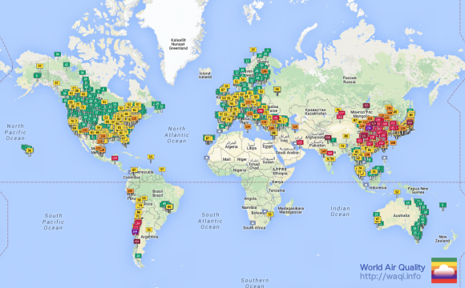
Agenda
Before the break: SPARQL-Generate
After the break: STTL
Management and browsing of existing RDF and non-RDF open data, including real-time sensor data

Slide 7
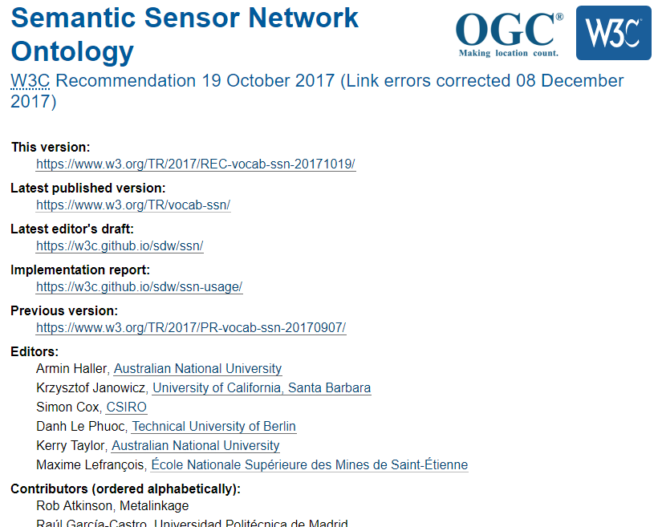
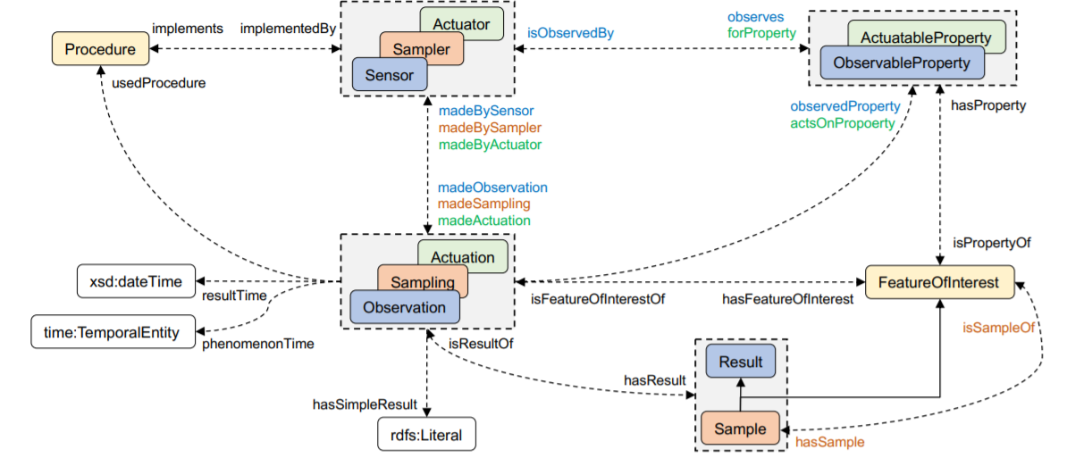
We will use (1/2)

Slide 8
We will use (2/2) The Unified Code for Units of Measure in RDF – cdt:ucum and other UCUM Datatypes
“UCUM is a code system intended to include all units of measures being contemporarily used in international sciences, engineering, and business.”
@prefix cdt: <http://w3id.org/lindt/custom_datatypes#>.
<room> ex:area "102 m2"^^cdt:ucum .
<room> ex:temperature "21.0 Cel"^^cdt:ucum .
<wall> ex:thermalConductivity "0.27 W/(m2.K)"^^cdt:ucum.
<car> ex:speed "26.3 [mi_i]/h"^^cdt:ucum .

